Slide 1



The ASG Annotation pipeline
….and how to investigate your annotations
Camilla Eldridge and Michael Paulini
Notes:
15th October
13:30-14:30
Trainers: Michael Paulini, Camilla Eldridge
Title: The ASG annotation pipeline: Assessing genome annotations and investigating gene models
Overview/Abstract:
The ASG annotation pipeline uses RNA-seq from the same species to annotate genomes without a reference genome. This session will provide an overview of how the pipeline works, explain the data generated by the pipeline and involves a short practical where the participants can explore the annotations in detail. By the end of the course participants should understand how their genomes will be annotated in ASG and how to evaluate the annotations they will receive to help inform future research in their target organisms.

Slide 2
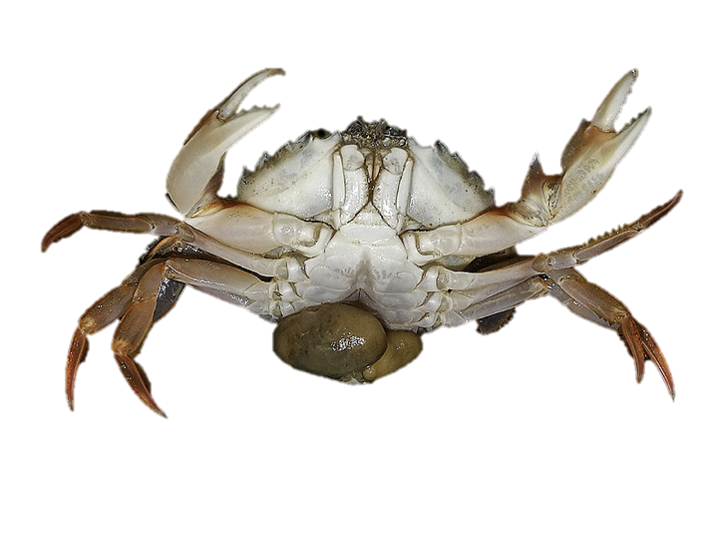
Learning objectives
Understand how the ASG annotation pipeline works and the theory behind it.
Learn how to evaluate your annotations.

Slide 3

ASG annotation pipeline
Assemblies curated to chromosome level
Aim: To annotate genomes from symbiont samples.
Perform annotations for different taxa across the tree of life.
Provide rapid, chromosome level annotation.
Send annotations to ensembl for hosting.
HiC map of qxSacCarc1

Slide 4
No ASG data in the pipeline yet
….but...

Slide 5
An Example!
qxSacCarc1 - Sacculina carcini
The crab hacker barnacle
A parasitic castrator!
Hijacks the host reproductive and nervous systems.
Parasitic barnacle of shore crabs.
Parasitic castrator....
eats the host’s genitals!!!
Cause male crabs to develop female characteristics.
Sacculina carcini
Assembly statistics available at: https://tolqc.cog.sanger.ac.uk/darwin/arthropods/Sacculina_carcini/
Notes:
Crab hacker barnacle
qxSacCarc
parasitic barnacle
Female larvae infect young crabs and develop inside the host for about 5 - 34 months before developing the externa.
infects male and female crabs,
castration and prevents further molts.
Host crabs may carry multiple infections of this parasite.
causes the males to develop female characteristics.

Slide 6
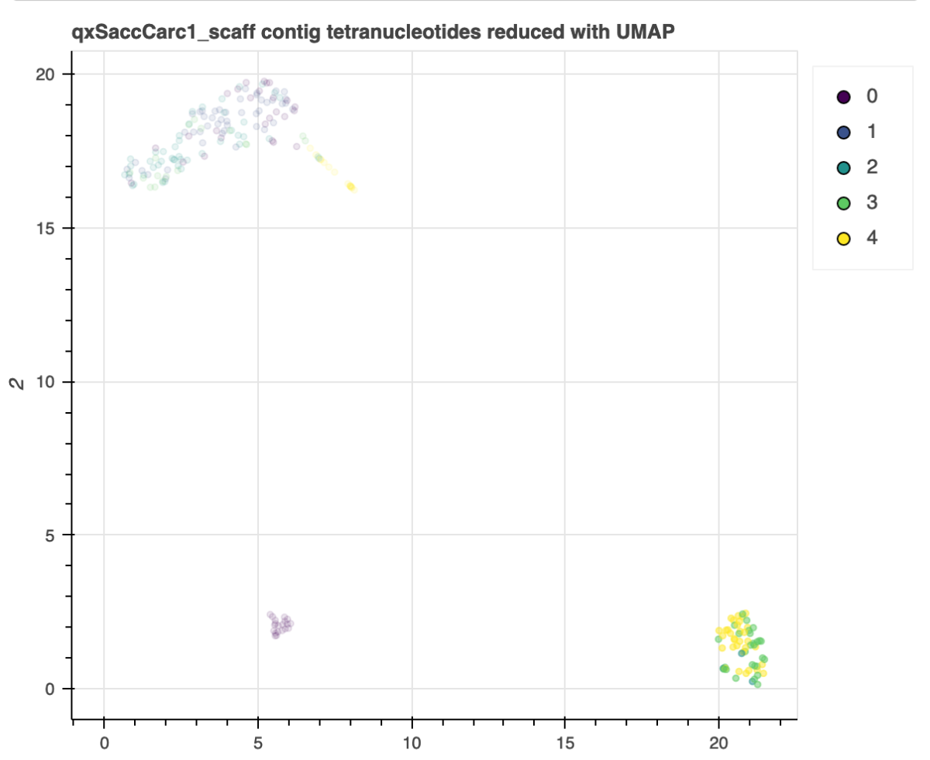
A pathogen, within a pathogen….
Multiple species in one sample...
Identified:
Vibrio atlanticus (pathogenic bacteria, gram negative).
qxSacCarc1
Vibrio atlanticus
Notes:
Could also be host contamination..

Slide 7
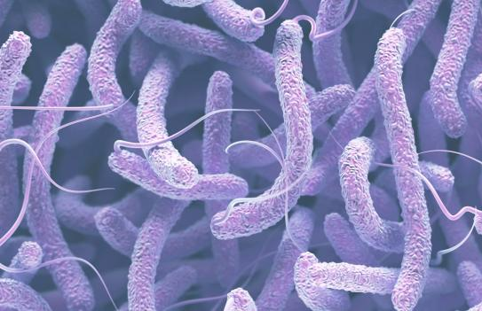
How would we annotate these genomes?
Sacculina carcini
Barnacle.
Eukaryote.
No reference genome*.
RNA-seq from the same species.
Vibrio atlanticus
Bacteria.
Prokaryote.
No RNA-seq*, but reference genome.
Sacculina carcini
Vibrio atlanticus
Notes:
For many of the eukaryotic species in this project there will be no reference genome available, so we our annotation method will rely heavily on the RNA-seq data(same species) for annotation.
For the vibrio example genome we won’t have RNA-seq but we do have a reference genome available...
* This is because to extract RNA-seq for bacteria and host you need to use a particular protocol….https://www.frontiersin.org/articles/10.3389/fmicb.2017.01830/full

Slide 8
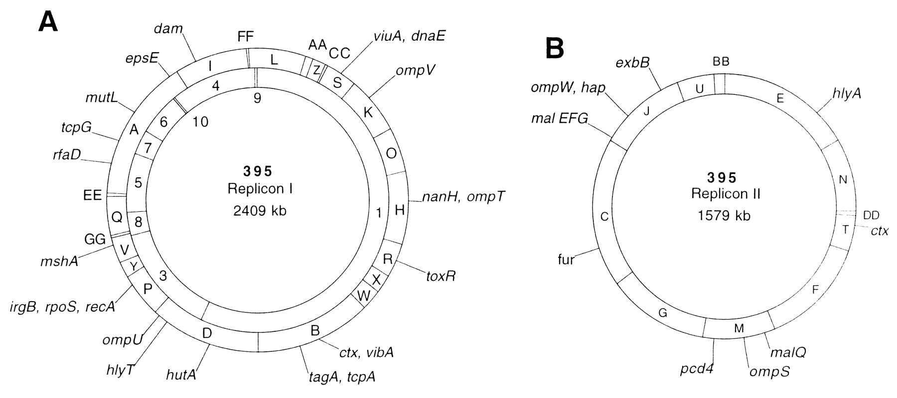
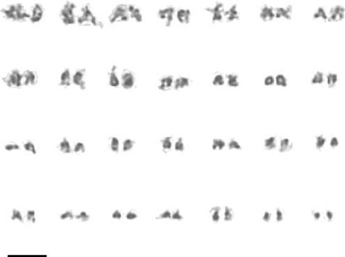
Prokaryotic vs Eukaryotic genomes
Proteobacteria
Arthropod
2 circular chromosomes
28 chromosomes (manually curated).
Vibrio atlanticus
Sacculina carcini
Introns.
Alternative splicing.
Long repetitive sequences.
Non-coding RNA’s
Estimated size ~609.7Mb.
Estimated n genes ~ 28,000
No introns.
Genome size ~5Mb.
4,420 proteins and ~100 RNA’s..
Notes:
https://www.uniprot.org/proteomes/UP000009100
Estimates from https://www.frontiersin.org/articles/10.3389/fevo.2019.00465/full

Slide 9
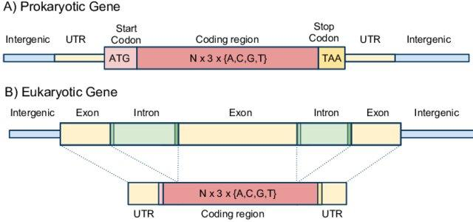
Prokaryotic vs Eukaryotic gene models
Proteobacteria
Arthropod
Sacculina carcini
Vibrio atlanticus

Slide 10
Annotation method (Eukaryotes)
Generate a repeat library and soft-mask the genome.
Map RNA-seq to the genome.
Train gene model predictors and generate annotations.
Sacculina carcini

Slide 11
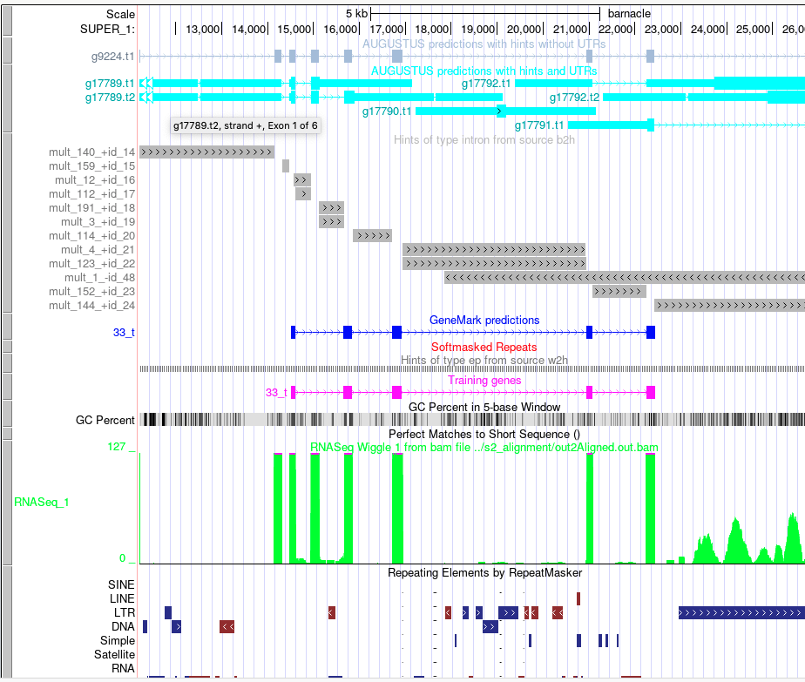
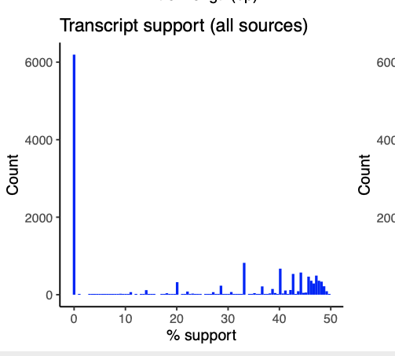
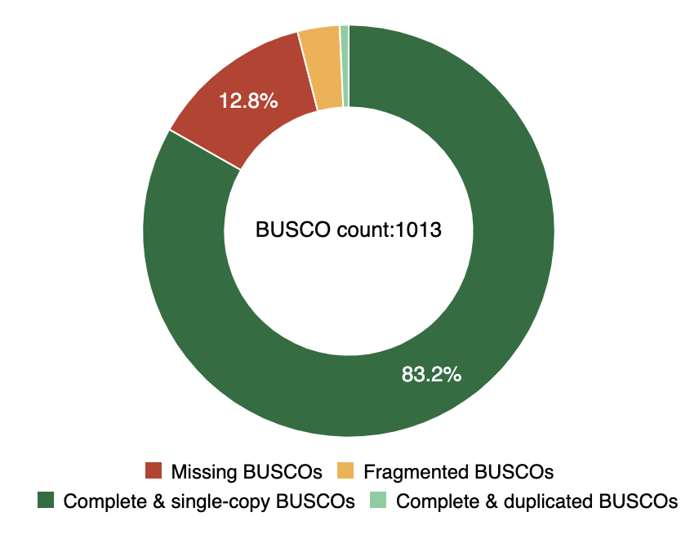
Pipeline overview (Eukaryota)
Part I
Curated genome
Part II
Masked curated genome
RNA-seq
Repeat Modeller
Gene model predictors trained on RNA-seq from the same organism.
STAR
Repeat Masker
Braker2
Masked curated genome
gff/gtf files
coding.fna
proteins.faa
Annotation evidence is loaded into the UCSC genome browser
UCSC hub
Summary stats and BUSCO
summary stats generated from gff/gtf output.
BUSCO run on coding fasta files

Slide 12
Generate a repeat library and soft-mask the genome.
Curated genome
How do we do it?
RepeatModeler generates a repeat library, classifies them and
RepeatMasker finds these repeats and soft-masks them. (lower case)
Why mask the genome?
Gene predictions are difficult in GC-rich long tandem repeats.
RepeatModeler
RepeatMasker
Masked curated genome
To note:
Long tandem repeats (LTRs) are often associated with protein-coding regions.
Repeat masking may mask over these repeats which could decrease gene prediction sensitivity.
Notes:
Can exclude TE’s from annotation/ likely won’t be annotated...viewed on hub...separately?

Slide 13
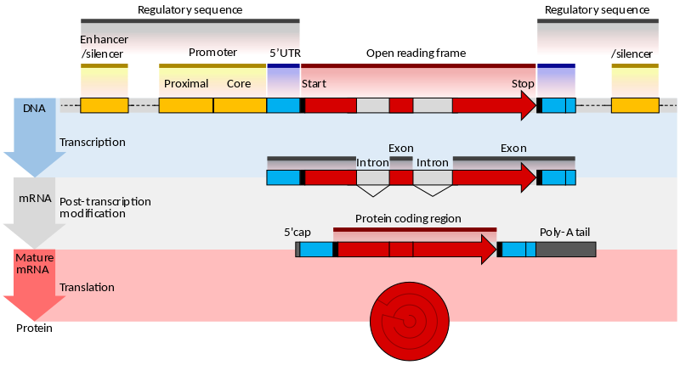
2. Map RNA-seq to the genome.
How is RNA-seq mapped to genome?
Create a genome index
Map reads to the genome using STAR.
RNA-seq are short fragments of mature mRNA (no introns).
Why map RNA-seq?
(Lomsadze et al., 2014)
By aligning cDNA back to the genome, intron boundaries can be estimated.
Think backwards!

Slide 14
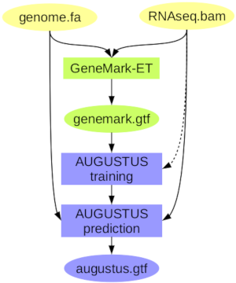
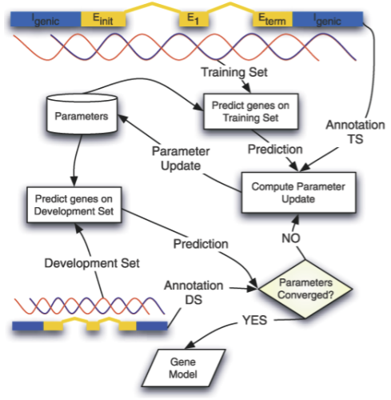
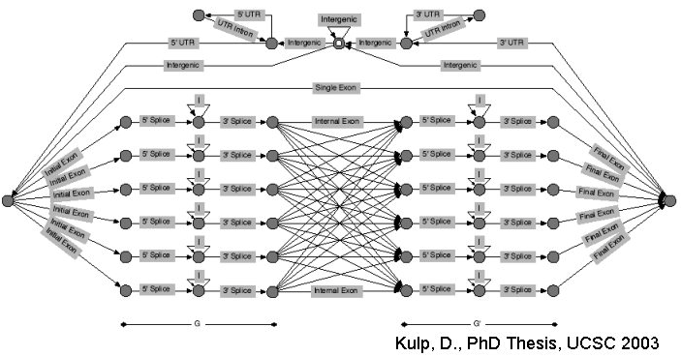
3. Train gene model predictors and generate annotations.
Why train gene model predictors?
To find parameters for gene prediction.
Genes that aren’t transcribed, or lowly expressed could be missing from RNA-seq data, some genes will need to be annotated ab initio.
How?
Braker2 uses Augustus and GeneMark.
Both use dynamic programming and a trained scoring system to predict coding regions. Which means a.) the results will not be 100% reproducible and b.) it needs training to come up with optimal parameters.
Why use the ‘no utrs’ option? The prediction of UTRs is difficult! .... our strategy is to use aligned transcripts to build UTRs after CDS prediction using GUSHR.
Notes:
How, we use braker-2 which involves multiple training steps. GeneMark-ET trained on RNA-seq (bam), to come up with a training gene set for augustus. Augustus is trained on GeneMark-ET seed genes and the RNA-seq.
At the moment we are trying different methods for example training with separate models for UTR’s.

Slide 15
Pipeline overview (Eukaryota)
Part I
Curated genome
Part II
Masked curated genome
RNA-seq
RepeatModeler
Gene model predictors trained on RNA-seq from the same organism.
STAR
RepeatMasker
Braker2
Masked curated genome
gff/gtf files
coding.fasta
proteins.fasta
Annotation evidence is loaded into the UCSC genome browser
UCSC hub
Summary stats and BUSCO
summary stats generated from gff/gtf output.
BUSCO run on coding fasta files
Notes:
So after the pipeline has been run we are left with the following output; Summary stats, BUSCO, the cds and protein sequences.

Slide 16
Annotation method (Prokaryota)
Gene model prediction with Prokka, uses Barrnap for rRNA prediction.
Input reference genome annotations(protein faa).
Output
Annotations are stored in a gbk file.
BUSCO.
Vibrio atlanticus
Notes:
We can use BUSCO fo the reference genome to compare the ‘completeness’ of our annotated genome.

Slide 17
Evaluating annotations without a reference!?
So far we have been using:
Summary information e.g gene and transcript numbers.
Summary information for the annotation is collected from the output gtf and gff files.
RNA-seq intron support.
Support from introns across each gene model is collected from augustus temp files.
BUSCO. BUSCO is run on final coding sequences output by Braker2.
Is this the real life……is this just fantasy?
Sacculina carcini
Notes:
Support is a percentage of number of introns that have a intron/exon junction supported with mapped RNA-seq reads.

Slide 18
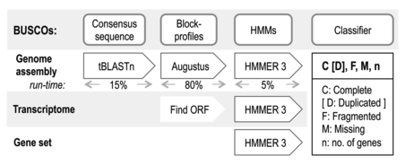
Assessing annotations
Sacculina carcini - Summary stats
Compare gene numbers to closest relatives.
Genes: 13,834
Estimated n genes
~ 28,000
 | Assembly | Braker2 annotation (trained without UTRS) | Braker2 annotation (trained with UTRS)
Complete | 83.9% | 89.9% | 48.8%
Single copy complete | 81.8% | 84.6% | 42.0%
Duplicated | 2.1% | 5.3% | 6.8%
Fragmented | 6.2% | 2.6% | 28.6%
Missing | 9.9% | 7.5% | 22.6%
Parasite!!
Can use BUSCO as a general metric to troubleshoot the annotation methods.
Predicts conserved orthologous groups.
Also, Gene models look short and separated
Sacculina carcini
Notes:
Arthropod lineage used for BUSCO..
Can also look at the number of full length transcripts.
Transcripts: 14,861
Transcripts (with both start and stop codons: 13,846)
And more summary stats...

Slide 19
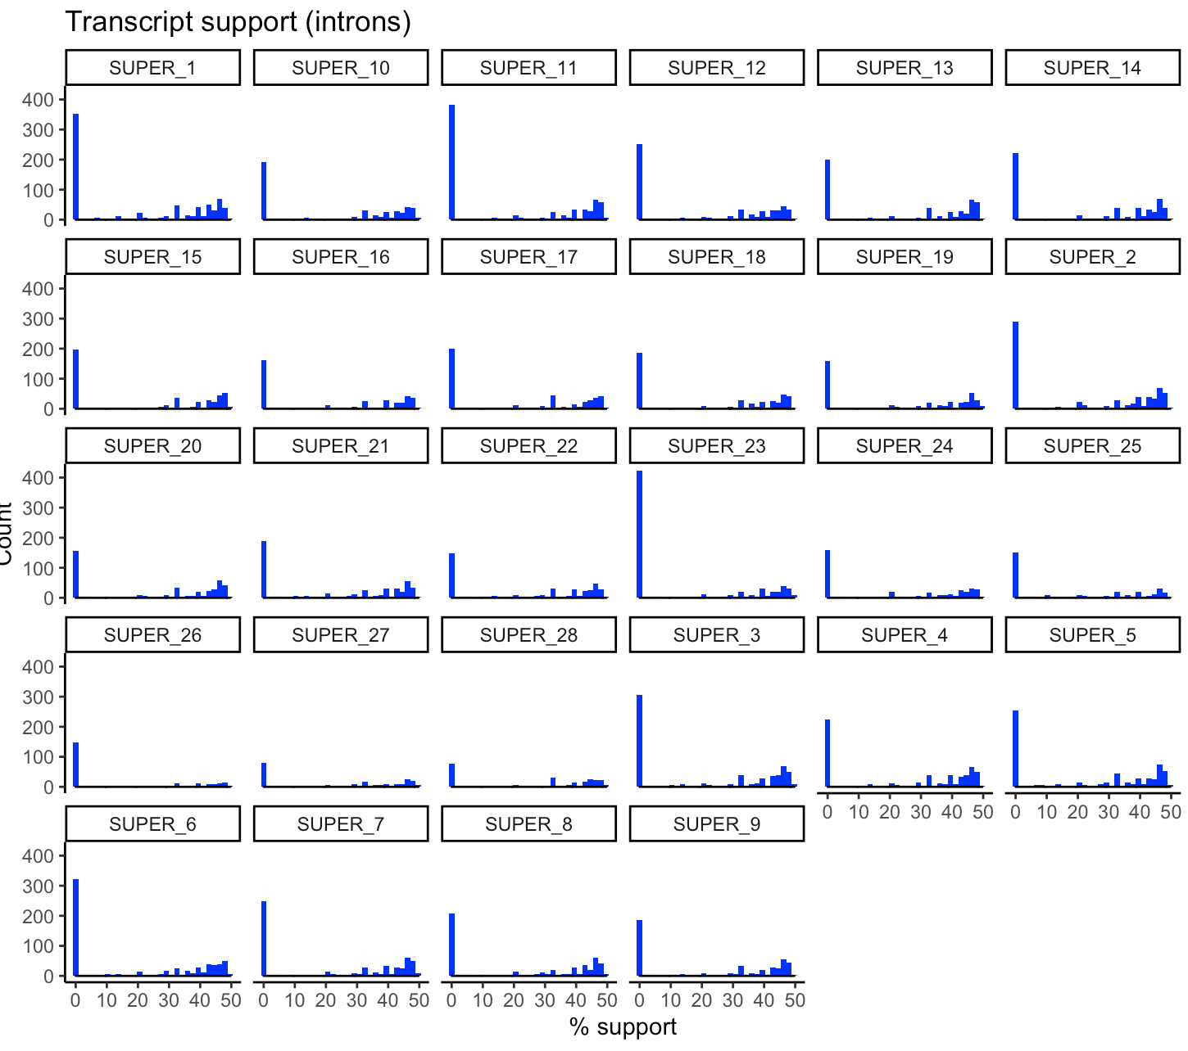
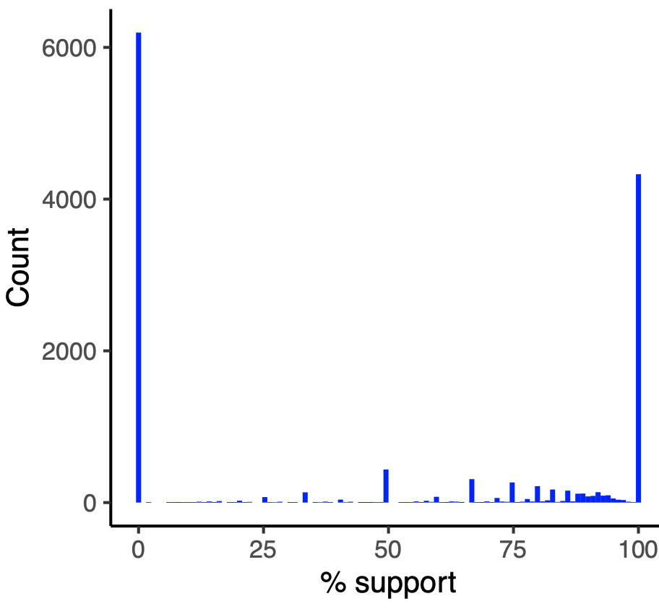
Sacculina carcini - Annotation support (introns)
Annotation support (RNA-seq) across chromosomes
Annotation support (RNA-seq support of intron boundaries) across entire genome.
Annotations without aligned RNA-seq (ab-initio)

Slide 20
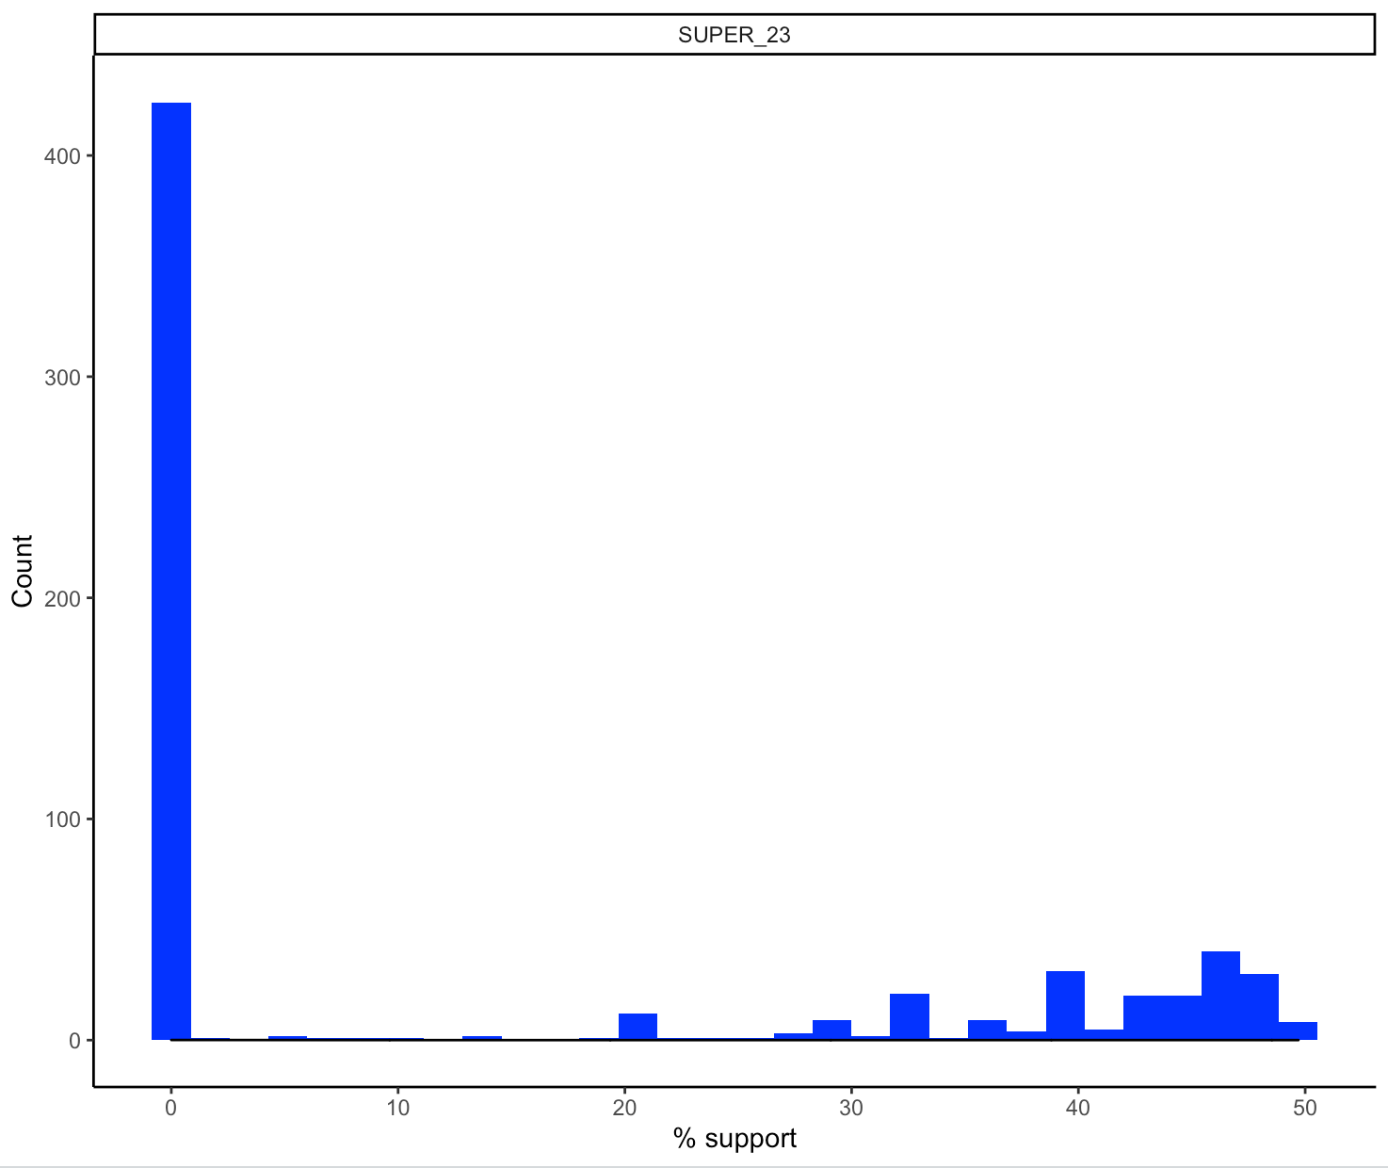
SUPER_23
Few annotations were directly supported by RNA-seq:
Is this biology (e.g missing transcripts due to low expression)?
All other annotations are generally not >50% supported by RNA-seq:
Did something go wrong during annotation? How can we tell?
Ab initio,
Not in the RNA-seq library?
Few introns supported by RNA-seq

Slide 21
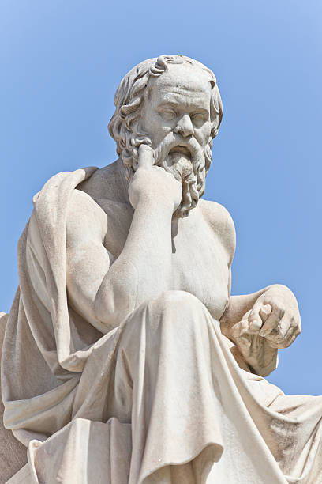
Some philosophy….
“To be uncertain is to be uncomfortable,
but to be certain is to be ridiculous.”
-Socrates
Gene models are predictions.
Relying only on RNA-seq for annotation has limitations; not all transcripts might be expressed/some with low expression (some predictions will have to be ab-initio).
BUSCO gives only a general estimate of genome completeness and the number of genes predicted could vary significantly from the closest relative.
With new genomes there could be gene structures that have never been seen before….we don’t know what we will find...
What is the best we can do with so much uncertainty...?

Slide 22
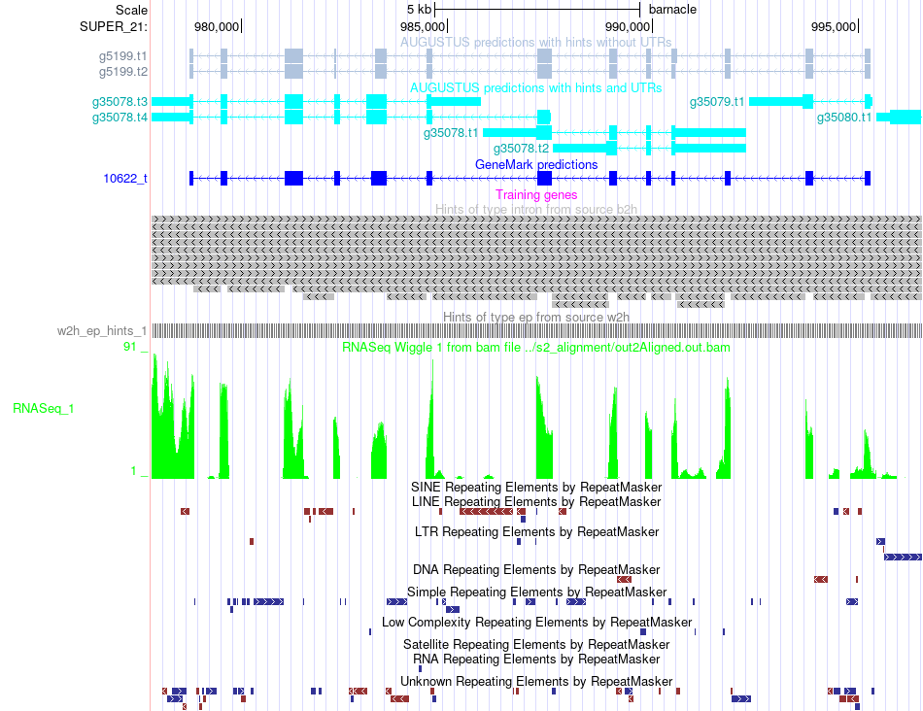
Using the UCSC genome browser to inspect annotations
We can look closer at the layers of evidence used in the prediction of gene models.
This can show us:
RNA-seq coverage for exons.
The location of intron hints.
Which training genes were used in prediction.
And give us an idea (for a particular gene of interest) how well supported the annotation is….
Notes:
Useful if studying pathways and interested in individual predictions……

Slide 23
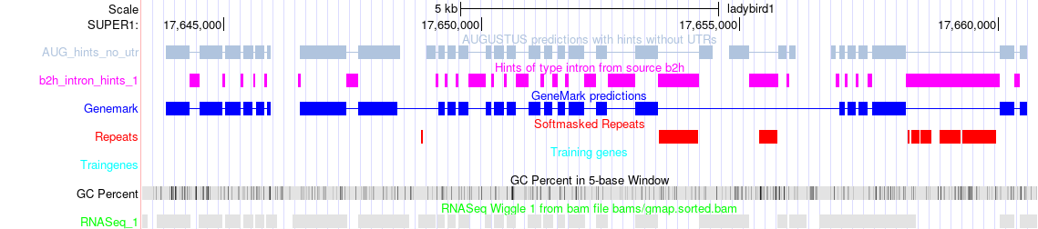
The UCSC browser
In the browser, annotation evidence and gene predictions are aligned….
Intron hints
Soft masked repeats
RNA-seq mapped to exons

Slide 24
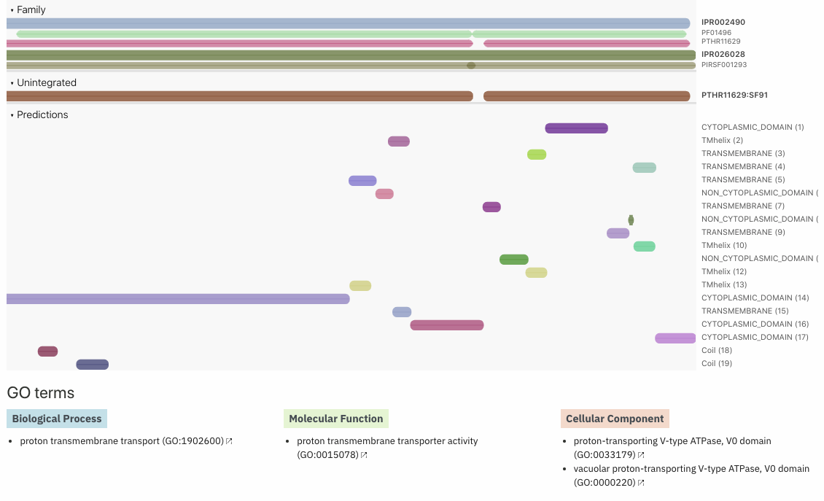
The ‘good’
Isoforms….. g5199 / unc-32 homolog
Location: SUPER_21:978744-995286
2 isoforms with an alternate splice site
“Essential component of the vacuolar proton pump (V-ATPase), a multimeric enzyme that catalyzes the translocation of protons across the membranes. Required for assembly and activity of the V-ATPase”
Notes:
Support for each exon and expression at the same level, identifiable functional domains and a conserved sequence.

Slide 25
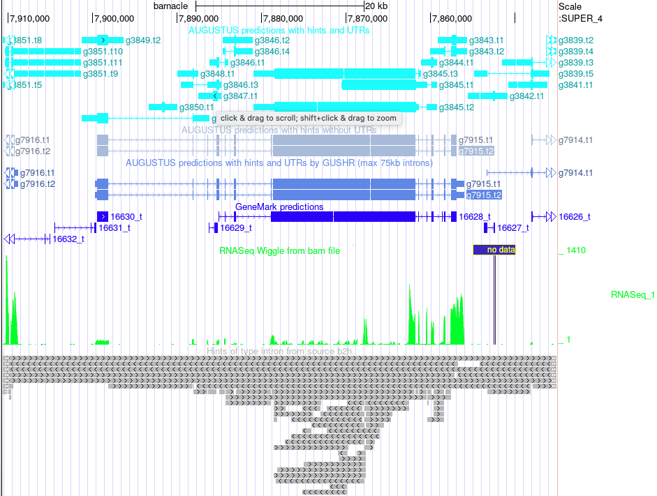
The ‘bad’ - longest exon
Notes:
g7915 longest exon - Stabilizer of axonemal microtubules 1/2 (IPR033336)(GO:0008017)
It has a large number of axo domains, which are located in that large exon.

Slide 26
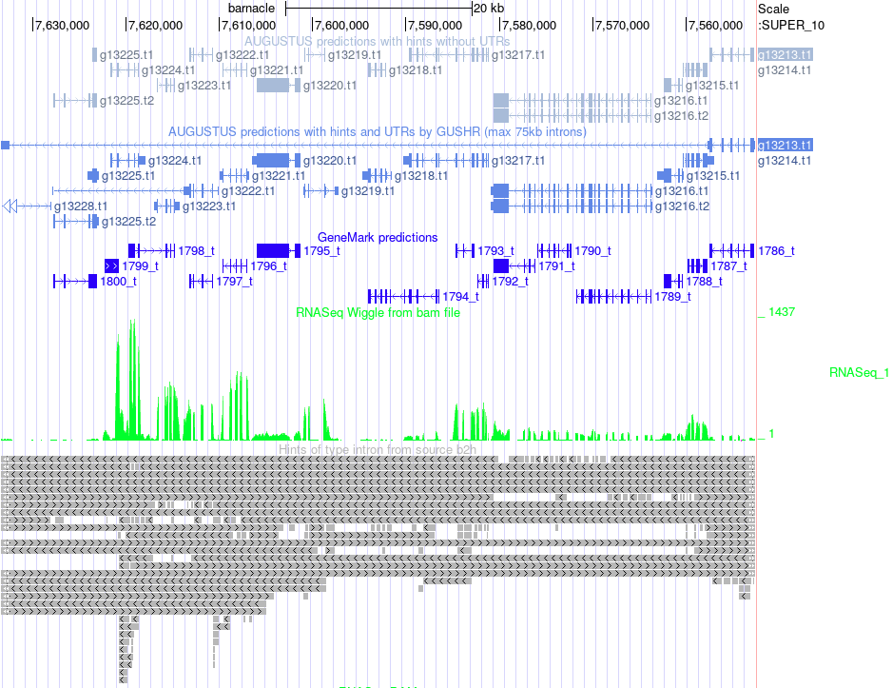
The ‘ugly’ - the longest intron
Notes:
g13213 longest intron - recombinatorial repair (GO:0000725)
There are some very large gaps in the RNASeq alignments, which leads to a very large “intron”. This might come from assembly issues, artefacts in the RNA library or alignment artefacts.

Slide 27
Time to try it out!
Scenario 1.
The pipeline has annotated a tetraspanin gene, looking in the braker.gff file you see this gene (g13722.t1) is located on the chromosome labelled SUPER_26, how would you look closer at this annotation?

Slide 28
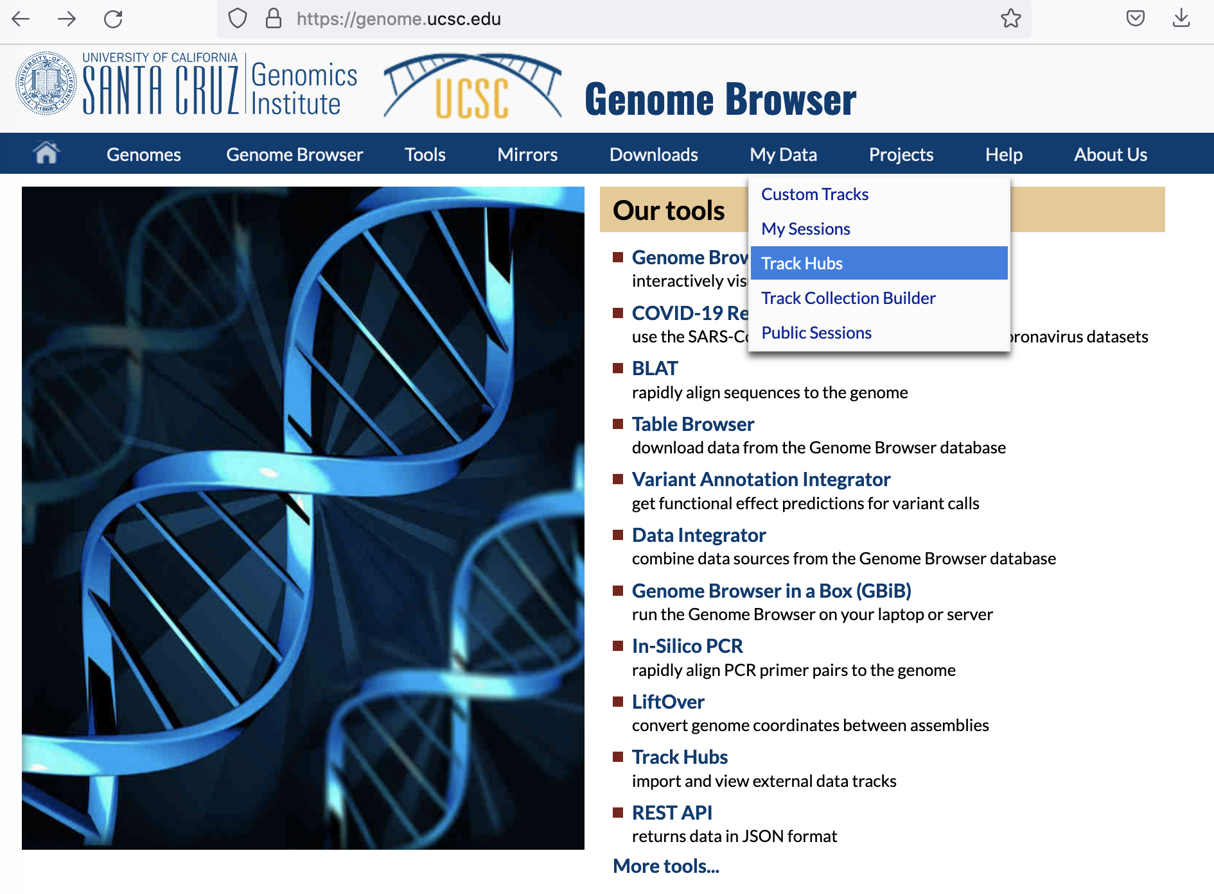
Go to ‘My Data’ then ‘Track Hubs’
https://genome.ucsc.edu/
Notes:
https://genome-euro.ucsc.edu/
https://genome.ucsc.edu/

Slide 29
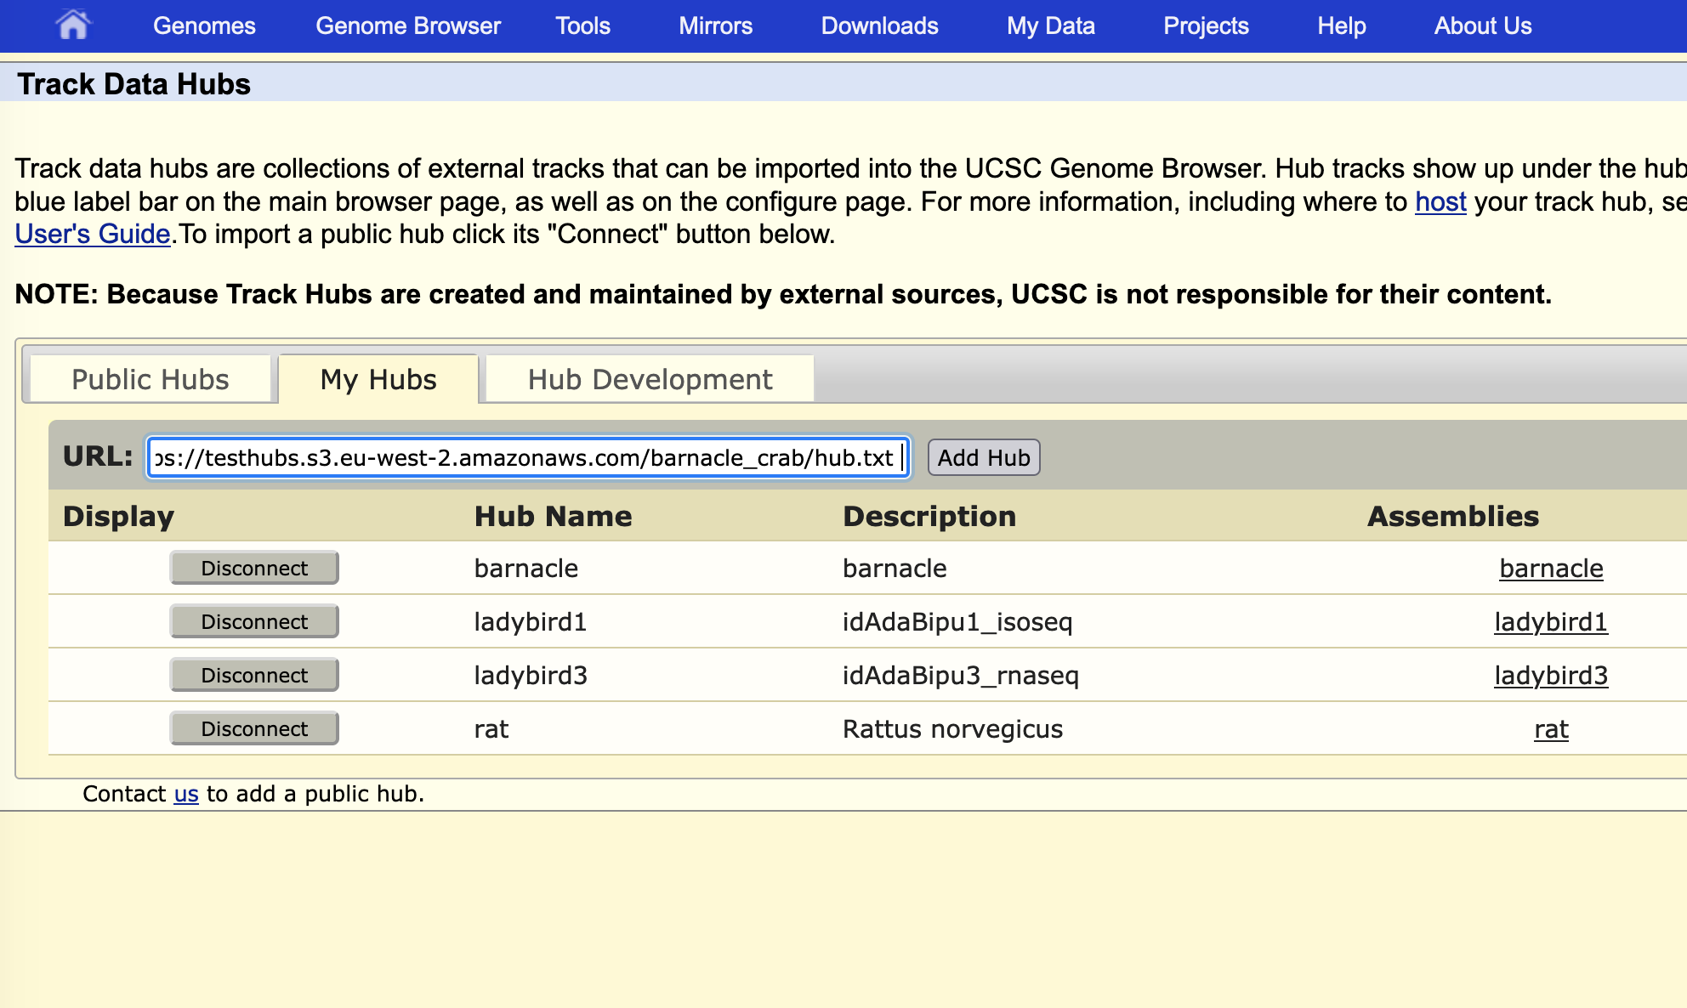
Under ‘My Hubs’ Copy and paste the URL: https://testhubs.s3.eu-west-2.amazonaws.com/barnacle_crab/hub.txt
Then click on Add Hub.

Slide 30
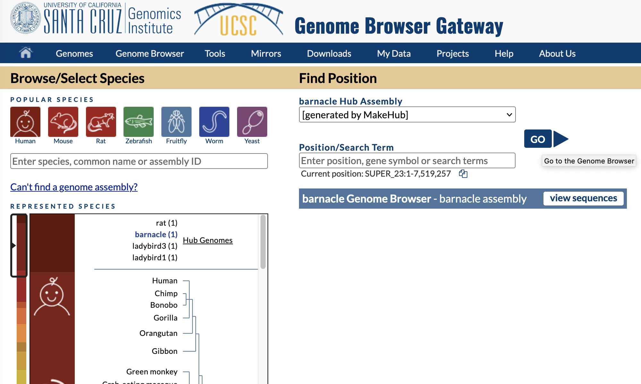
Click on ‘GO’ to get to the browser
Notes:
The new genomes can be found under “Genomes”

Slide 31
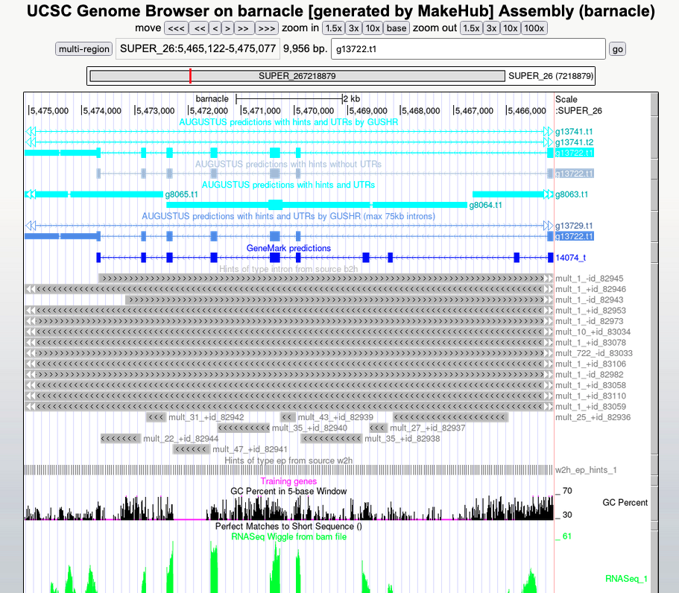
Search for g13722.t1
Click go
Type in gene id

Slide 32
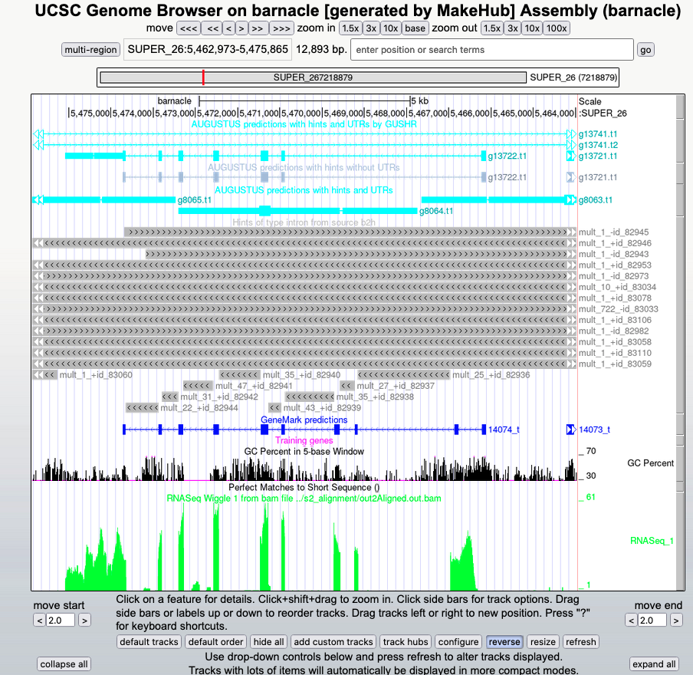
Getting the sequence for a particular annotation: g13722.t1
Click on the gene
Notes:
Explain the tracks….

Slide 33
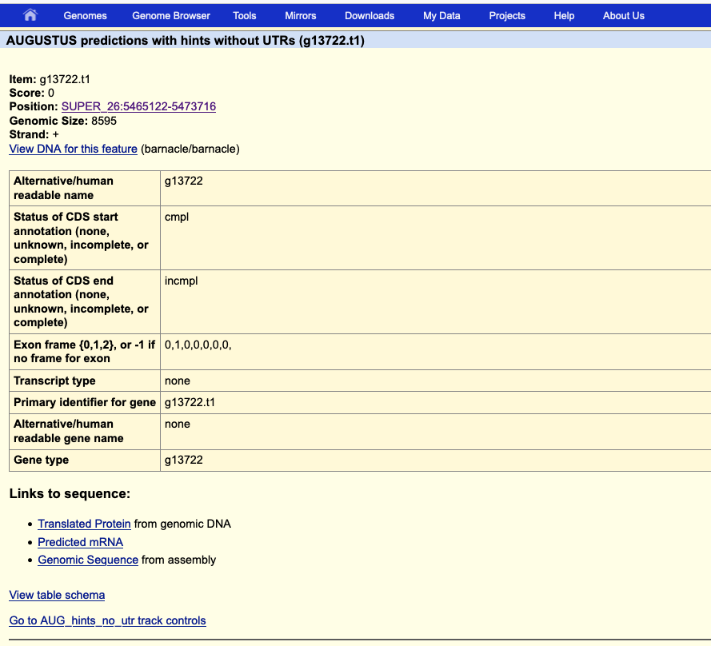
Click on the links to sequence...

Slide 34
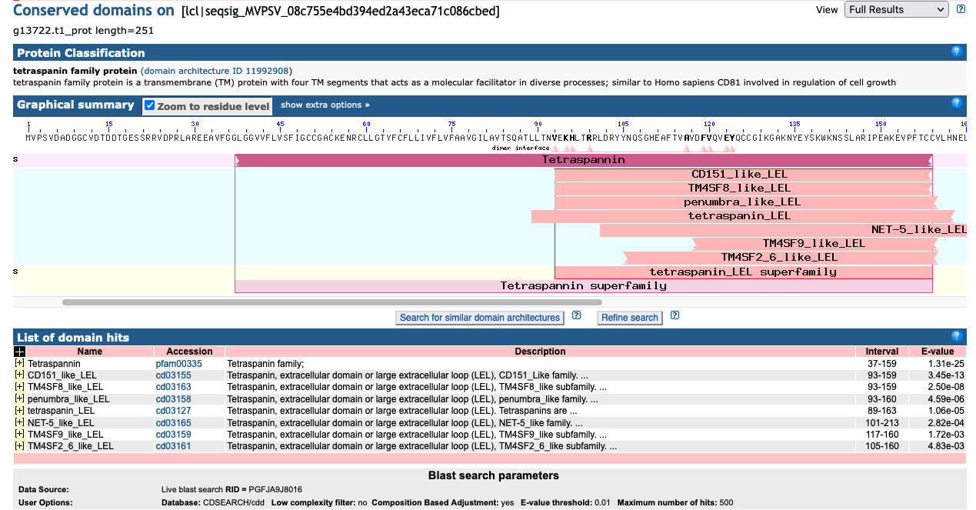
Domain search reveals full Tetraspanin domain...
What do we think?

Slide 35
Scenario 2.
You want to explore possible interactions between Vibrio atlanticus and Sacculina carcini, you found a protein with a predicted peptidoglycan binding domain in one of the S.carcini gene predictions (g2128.t1), before you dive into functional hypotheses, what does the annotation look like?
Let’s go to g2128.t1 on SUPER_ 5
Notes:
Imagine you have received your annotations,
Another example…..B-cell receptor example….it shouldnt be there...

Slide 36
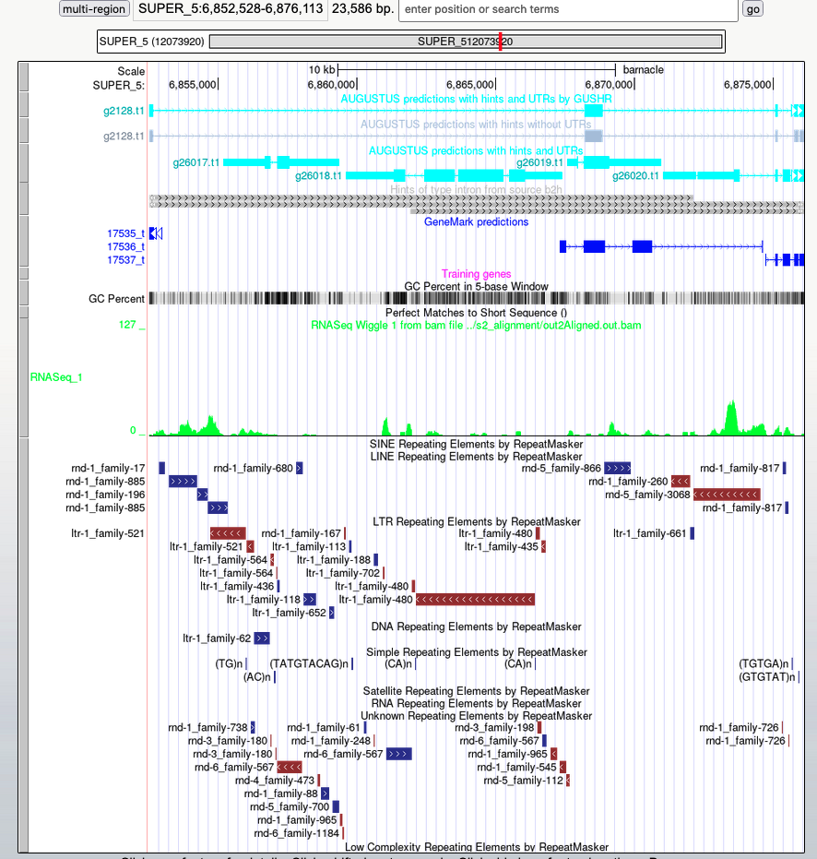
Position on chromosome
g2128.t1
predicted peptidoglycan binding protein
RNA-seq coverage
Notes:
Configure rna-seq, autoscale….
Coverage of transcript should be similar……

Slide 37
Scenario 3.
g6055.t1 was annotated as a B-cell associated protein, (arthropods don’t have B-cells), is this a bad annotation?

Slide 38
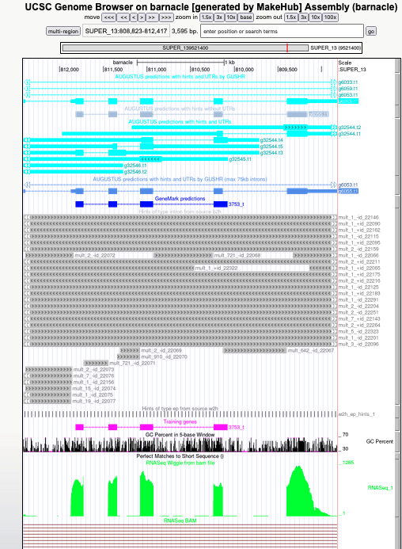
No, it looks pretty good!
So what’s going on?
Get the protein sequence.
BLAST.

Slide 39
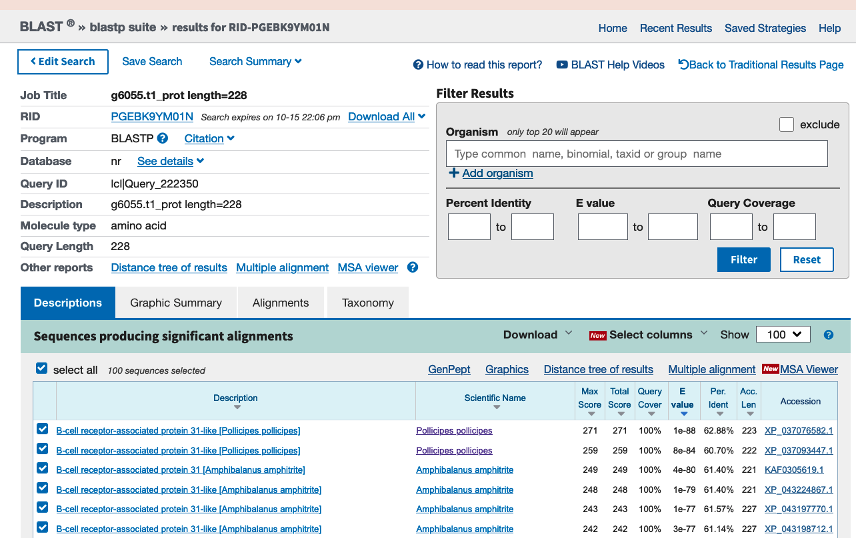
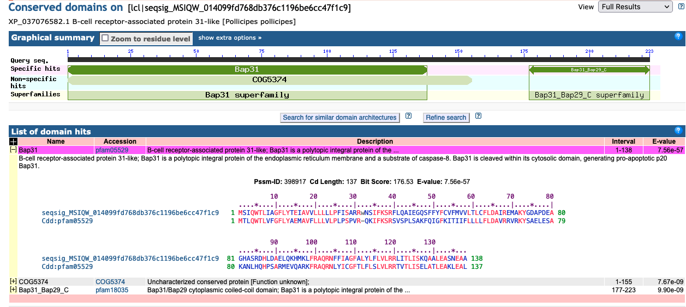
‘What's in a name?’
CDD search also reveals hit to B-cell-like protein...
Notes:
This may be a common occurrence with new genomes….

Slide 40
Finally….
If you want to use the pipeline yourselves, it will be available on github….!
If you want to play around with the example files, you can access them by doing:
git clone https://github.com/Aquatic-Symbiosis-Genomics-Project/ASG_annotation_course.git
We have generated some preliminary functional annotations using eggnog (eggnog.xlsx)
For more help with the browser:https://genome.ucsc.edu/goldenpath/help/hgTrackHubHelp.html
Notes:
https://github.com/Aquatic-Symbiosis-Genomics-Project/ASG_annotation_course.git

Slide 41
Some further reading...
Mario Stanke, Mark Diekhans, Robert Baertsch, David Haussler (2008). Using native and syntenically mapped cDNA alignments to improve de novo gene finding. Bioinformatics, 24(5), pages 637–644, doi: 10.1093/bioinformatics/btn013
Lomsadze A., Burns P.D. and Borodovsky M.
"Integration of mapped RNA-Seq reads into automatic training of eukaryotic gene finding algorithm." Nucleic Acids Research, 2014, July 2, doi: 10.1093/nar/gku557
https://academic.oup.com/nargab/article/3/1/lqaa108/6066535
https://oup.silverchair-cdn.com/oup/backfile/Content_public/Journal/nargab/3/1/10.1093_nargab_lqaa108/1/lqaa108_supplemental_file.pdf?Expires=1636141971&Signature=A0PST~6xEWC4WicyprMRh5-MVQ8TpgvbTz61gkkPua35jSzqMwtU-pczqNFmQ933WjgVkqw8eFxT4jU50jCOnI6G3QqRXuhUXztfe9LnXaQawlnglu42~zWh1-Ekk8adiBT3rn9-Pfl1X8f4OIVIssSlcbHpIog~2ycy2vumFwmuQ6M85zSMdThvOQ1mcZFXumrJV~CiCo41~5sPRROx6pYS5w5zdPIVwM02Kh5eyrfx5zqMW8oHjlhN0qLeElwtZ2qflm5WX2CJjOHbFMBioCsoTXqjXMioavN~8vGHFdKy0jFk2wYFKX1vByQOXj-shsOj~KcWLSRS0rK2BQDaTQ__&Key-Pair-Id=APKAIE5G5CRDK6RD3PGA
https://academic.oup.com/nar/article/47/21/10994/5580909
https://academic.oup.com/nargab/article/2/2/lqaa026/5836691
Images; https://commons.wikimedia.org/wiki/File:Gene_structure_eukaryote_2_annotated.svg, File:Sacculina carcini (double infection).jpg - Wikimedia Commons, https://www.downtoearth.org.in/news/health/climate-change-increasing-threats-from-vibrio-bacteria-study-6775

